Slide 1
The USMCA and the U.S.-Canada Trade Relationship
Tough Times in Farm Country: Taking the Pulse of the Agricultural Trade Climate
Presented to
American Agricultural Law Association
October 23, 2019
Presenter
Jessica B. Horwitz
Bennett Jones LLP

Slide 2
Outline
Timeline and Context
USMCA: What’s New for Agriculture
Prospects for Ratification

Slide 3
Renegotiation Context:
“Trade Wars”

Slide 4

USMCA – Overview

Slide 5

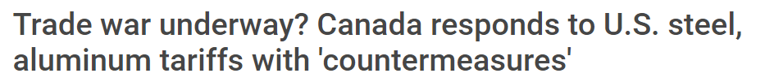
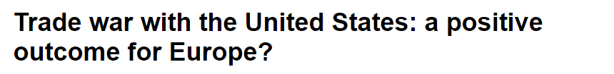
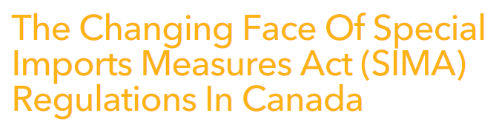
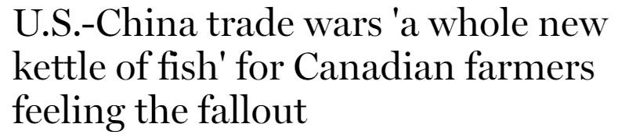


Slide 6
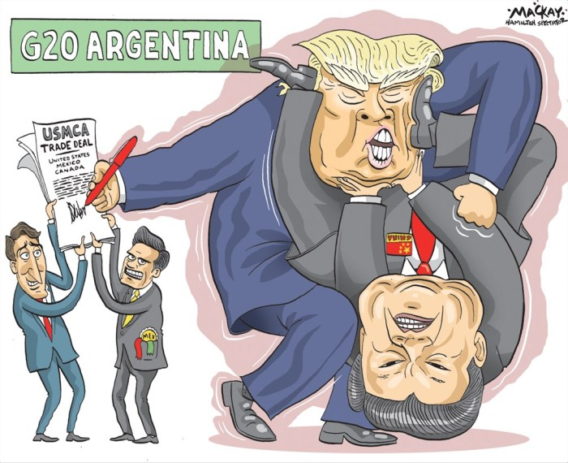
NAFTA Renegotiations – USMCA (CUSMA)
Trump campaign promise
NAFTA trilateral trade agreement
came into force on Jan. 1, 1994
Negotiations concluded September
30, 2018
Signed on November 30, 2018
What’s in a name?
  USMCA, CUSMA, MUSCA / T-MEC?
Will not come into force until it is ratified
Agreement signing tempered uncertainty, even if timing for implementation is uncertain

Slide 7
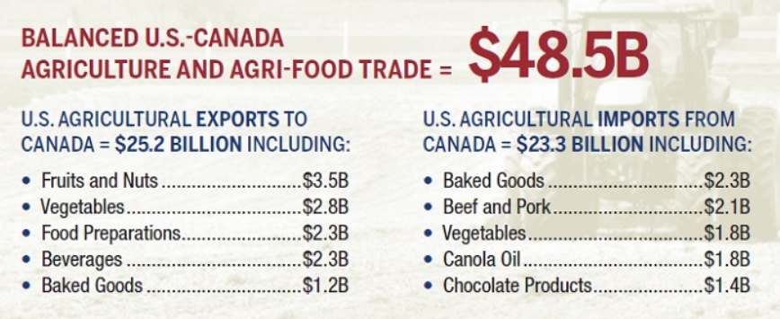
Canada-U.S. Agricultural and Agri-Food Trade
Canada and Mexico are the United States’ top agricultural export markets, totaling a combined $40 billion in 2018 (including $15 billion in processed food & beverage products)
29% of all U.S. farm and food exports went to Canada and Mexico in 2018, supporting over 300,000 American jobs. (Source: USDA)
Source: Agriculture and Agri-Food Canada

Slide 8
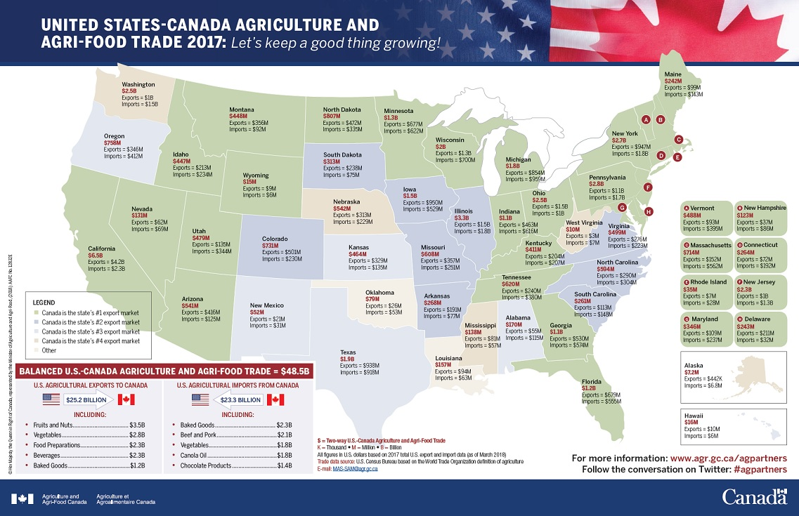

Slide 9
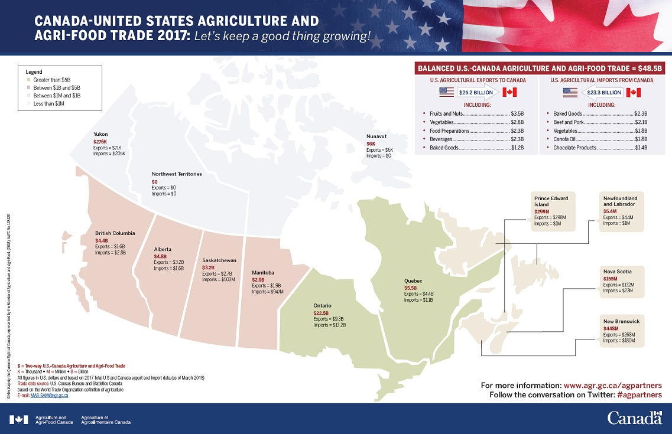

Slide 10
USMCA: What’s New for Agriculture?

Slide 11
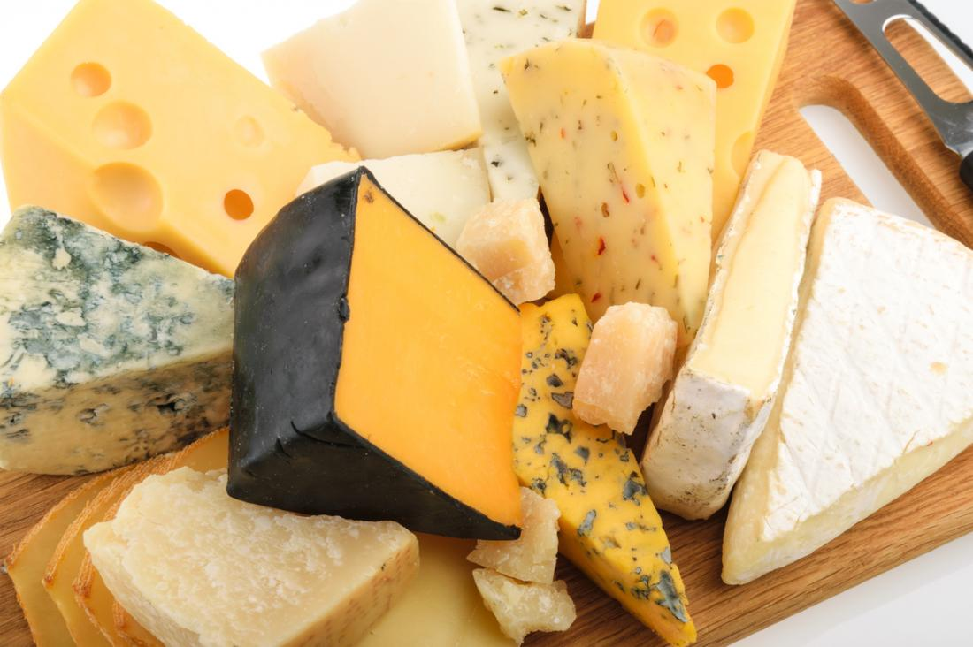
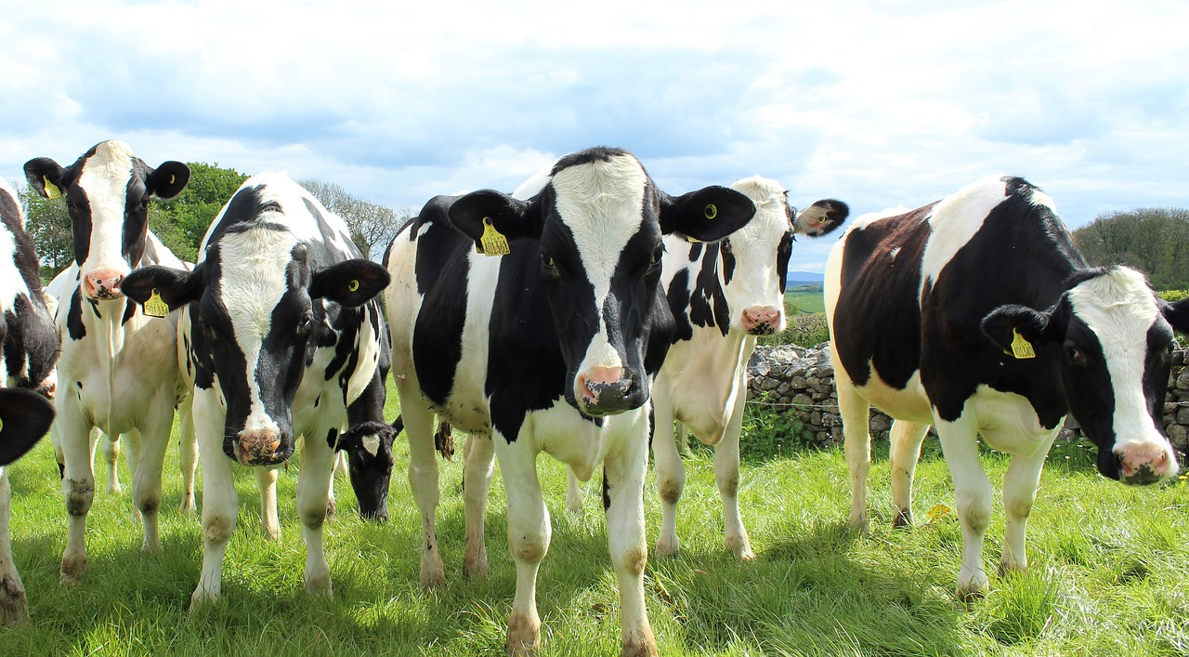

Dairy – TRQ Concessions (Canada)
Canada granted dairy quota to U.S. worth approx. 3.6% of market
Slightly higher than what had been negotiated in CPTPP
CANADA – Additional TRQs for Imports from U.S.
Milk | 50,000 MT by year 6
Cream | 10,500 MT by year 6
Skim milk powder | 7,500 MT by year 6
Butter and cream powder | 4,500 MT by year 6
Cheese (Industrial) | 12,500 MT by year 6: 6,250 MT industrial bulk 6,250 MT any kind
Other products of natural milk constituents | 2,760 MT by year 6

Slide 12
Dairy – TRQ Concessions (Canada)
CANADA – Additional TRQs for Imports from U.S.
Milk powders | 690 MT by year 6
Concentrated or condensed milk | 1,380 MT by year 6
Yogurt and buttermilk | 4,135 MT by year 6
Powdered buttermilk | 520 MT by year 6
Whey powder | 4,135 by year 6 (*TRQ eliminated after 10 years)
Ice cream and mixes | 690 MT by year 6
Other dairy | 690 MT by year 6
Access for U.S. tonnage will increase by one per cent for an additional 13 years (to year 19)
  Except for whey powder, which increases to 10 years after which it is eliminated (and tariffs go to zero)

Slide 13
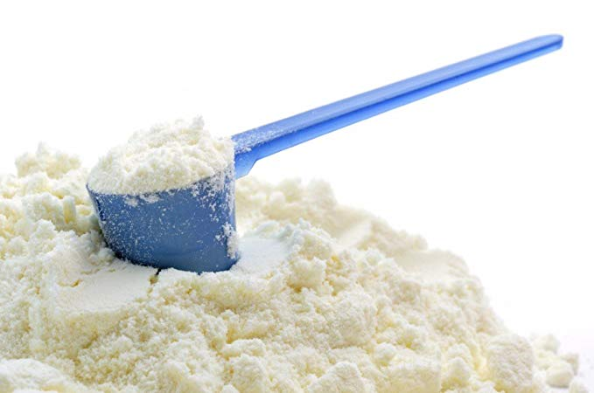
Dairy – Other Canadian Concessions
Canada agreed to eliminate Classes 6 and 7 milk pricing
  Class 7 was created in March 2017 as part of Canadian Dairy Commission and provincial milk boards “National ingredient strategy” to make price of domestic milk ingredients more competitive with imports
Export quotas and price controls (match U.S. market price) for milk protein concentrate, skim milk powder and infant formula
Canada also agreed to resume its program to use skim milk domestically as animal feed

Slide 14
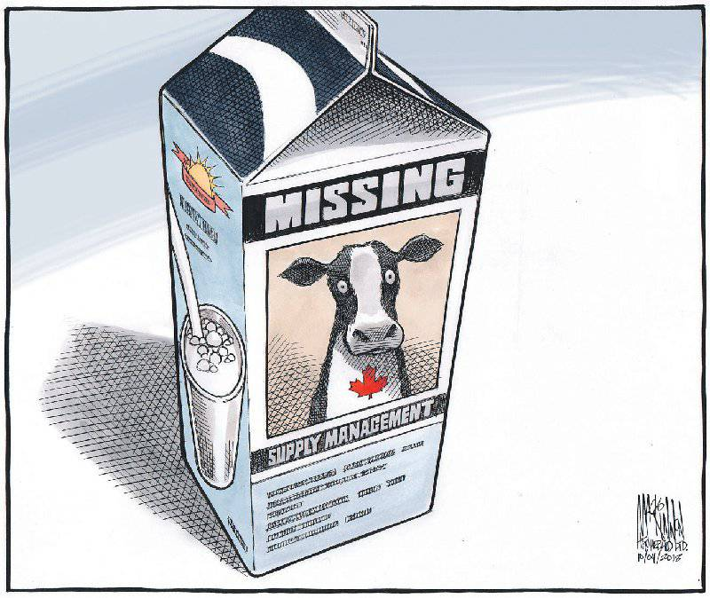
Dairy – TRQ Allocation
Quota allocated on “dairy year” basis August 1 to July 31
TRQ will be allocated to “eligible participants”
  Active participants in the Canadian food or
  agriculture sector
  Previous importations not required
Allocations are not first come first served
  Applications are considered by Global Affairs Canada (Import Trade Controls Policy Division)
  Designated application periods annually
  TRQ typically allocated to traditional historic import allocation holders
Specific import permits required to claim allocation
If over-access, GIP under EIPA must still be claimed
(and duties apply)

Slide 15
Dairy – TRQ Concessions (USA)
USA – Additional TRQs for Imports from Canada
Fluid cream, sour cream, ice cream, milk beverages | 10,500 MT by year 6
Skim milk powder | 7,500 MT by year 6
Butter, cream, cream powder | 4,500 MT by year 6
Cheese | 12,500 MT by year 6
Whole milk powder | 690 MT by year 6
Dried yogurt, sour cream, whey and products of milk constituents | 11,030 MT by year 6
Concentrated milk | 1,380 MT by year 6
Other dairy | 1,900 MT by year 6
+ additional 1% per year for 13 years

Slide 16
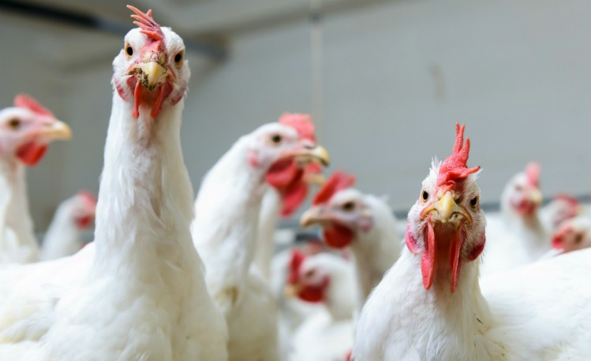


Canadian Concessions on Poultry, Eggs
Canadian quota levels for poultry and eggs increased
Chicken – 57,000 MT by year 6, + additional 1% per year for 10 years
Eggs – 10 million dozen eggs and egg-equivalents by year 6 + additional 1% per year for 10 years
Turkey, turkey products – WTO access guaranteed at no less than 3.5% previous year’s total (translates to 1,000 MT per year extra for U.S. and potentially more)

Slide 17


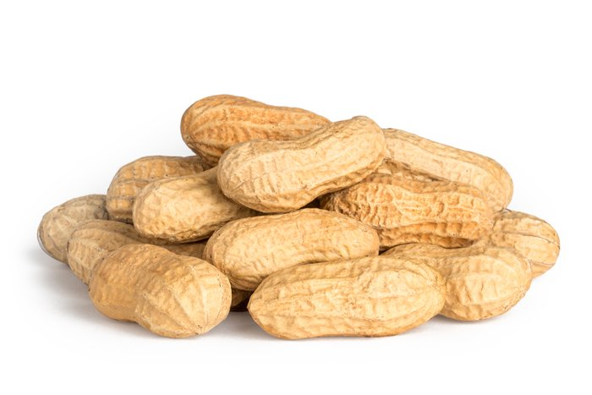
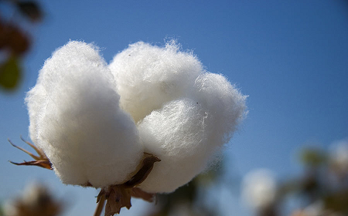
Sugar and Sugar Containing Products, Peanuts, Cotton, Margarine
U.S. increased quota for Canadian sugar and sugar containing products
  Beet sugar, cane sugar, refined sucrose - 9,600 MT
  Maple syrup, syrups, chocolate, confectionery etc. – 9,600 MT
TRQs on Canadian peanuts, peanut butter and cotton, and on U.S. margarine will be phased out over 5 years
  Margarine rule of origin for use in trade between U.S. and Canada will allow the use of non-originating palm oil

Slide 18
Other Market Access Points
Notice and consultation required for future changes to tariff schedule involving dairy, poultry and egg, changes to milk pricing
Meet after 5 years (and every 2 years thereafter) to discuss milk pricing.
Increased transparency in import licensing procedures for TRQ administration
  public advance notice of TRQ administration changes, published utilization rates, written reasons for denying import licenses

Slide 19


Wine, Beer and Distilled Spirits
Annex on wine, beer and distilled spirits
  Addresses BC, Ontario and Quebec regulations limiting foreign liquor
  National treatment for distribution, listing requirements
  Specific labelling rules to prevent labelling from being a non-tariff barrier
  Limits on differential in cost markups
Chapter 3 - GI protections:
  “Bourbon Whiskey”, “Tennissee Whiskey”, “Canadian Whiskey”,
  “Tequila”, “Mezcal”
Side letter on British Columbia wine

Slide 20
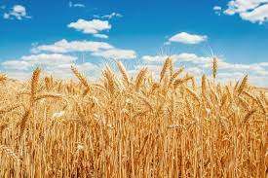
Equal Treatment of Grain Quality Grades
Quality grades for grain will be granted mutual national treatment
  Parties shall accord “treatment no less favorable than it accords to like wheat of domestic origin with respect to the assignment of quality grades.”
Currently, Canada does not recognize U.S. grades, so U.S. wheat is priced as feed wheat in Canada
No country of origin can be required on wheat quality certificates

Slide 21

Protection of Proprietary Formulas
Annex 3-D: Rule that Parties shall not request information about proprietary formulas for prepackaged foods unless
  Request is limited to only what is needed to achieve legitimate objective
  Confidential information is protected

Slide 22
Geographic Indications – Chapter 20
Recognition and accommodation of GIs agreed with other states
  Side letter between USA and Mexico lists 33 cheese names that will remain common as between USA and Mexico (which Canada must protect under the CETA)
Processes for requesting new GI protections including transparency and notification requirements
Detailed process for determining whether a food name is “common”

Slide 23
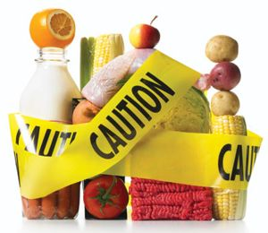
Sanitary and Phytosanitary Measures – Chapter 9
SPS Chapter Modernized
Recognition that greater compatibility is required
Call for greater transparency in development and implementation of SPS measures, equivalence assessments
Rules for the conduct of audits, import checks
New mechanisms for technical consultations

Slide 24

Agricultural Biotechnology and GMOs
Section B of Chapter 3 specifically addresses biotechnology
Parties “confirm the importance of encouraging agricultural innovation and facilitating trade in products of agricultural biotechnology”
Transparency and access requirements for regulations and information on authorization for new products
Authorization requests to be reviewed in timely manner
Parties to communicate regarding new and existing authorizations to improve information exchange
Working Group to be established

Slide 25
“agricultural biotechnology means technologies, including modern biotechnology, used for the deliberate manipulation of an organism to introduce, remove, or modify one or more heritable characteristics of a product for agriculture and aquaculture use and that are not technologies used in traditional breeding and selection”

Slide 26
What didn’t make it in?
Proposal by southwestern U.S. produce growers to change trade remedy laws to address seasonal produce
Non-tariff barriers to market access for U.S. fresh potatoes in Canada and Mexico
Did not address the Canada and Mexico retaliatory countermeasures on food products (but that was subsequently resolved by negotiated settlement)

Slide 27
Other Notable Non-Agriculture Items

Slide 28
USMCA – Trade in Goods – General Provisions
Chapter 4 addresses Rules of Origin
  De minimis (tolerance) threshold for tariff shift rules of origin increased to 10% from 7%
Chapter 7 addresses trade facilitation
  Express (courier) shipments de minimis thresholds increased - $150 for duties, $40 for tax (up from $20)
Chapter 19 addresses Digital Trade
  Confirms no customs duties on digital products
  Parties must endeavor to accept trade administration documents submitted electronically
  Parties must adopt a legal framework that provides for the protection of personal information of digital trade users

Slide 29
USMCA – Other Notable Items
Automotive Rules of Origin, exemption from s.232 for autos
ISDS and Procurement access no longer applicable for Canada
  Chapters still apply applies for Mexico, and Canada still has coverage with Mexico through CPTPP
Intellectual Property – Longer terms for patent, copyrights
Change in wording of National Security provision
Numerous Side Letters
Chapters on labour (23), the environment (24), trade promotion for small and medium enterprises (25), anti-corruption (27), good regulatory practices (28)

Slide 30

USMCA – National Security Tariffs
s.232 tariffs on steel and aluminum were not resolved in the USMCA but were discontinued for Mexico and Canada in May 2019
Side letter - 60 day notice period before future measures will apply to Canada or Mexico
USCMA National Security clause less robust than NAFTA’s

Slide 31
USMCA – Non-Market Economy Clause
Article 32.10:
  2. At least 3 months prior to commencing negotiations, a Party shall inform the other Parties of its intention to commence free trade agreement negotiations with a non-market country.
  5. Entry by a Party into a free trade agreement with a non-market country will allow the other Parties to terminate this Agreement on six months’ notice and replace this Agreement with an agreement as between them (bilateral agreement).
Highly unusual
Not a restriction on sovereignty per se – but a signal from US that an FTA with China will cause issues

Slide 32
Prospects for Ratification?

Slide 33

USMCA Prospects for Ratification
Fall 2019 is feasible, 2020 more likely
Mexico has already ratified
Canadian implementing legislation is ready
to go, but Canada is waiting on the U.S.
  Both Liberals and Conservatives support passing the CUSMA
U.S. ratification depends largely on US congressional politics
  Labour, Environment, IP, DSM chapters are contentious to Democrats in House
  House Ways & Means Committee working group to address concerns
  Impeachment inquiry could distract

Slide 34


Thank you
Jessica Horwitz
Associate, International Trade & Investment
416.777.6517
horwitzj@bennettjones.com

